Slide 1

Numbering System

Slide 2

Part One

Slide 3
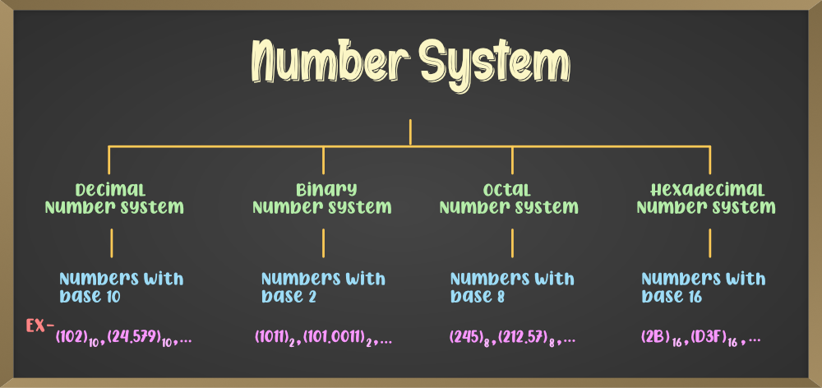
Understand the decimal , binary, octal and hexadecimal number systems.

Slide 4
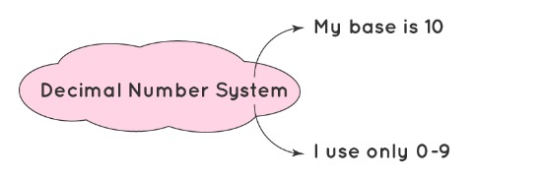
1- Decimal Number System

Slide 5
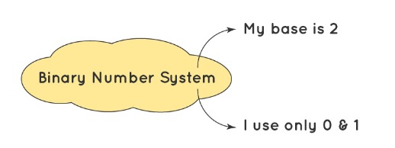
2- Binary Number System

Slide 6
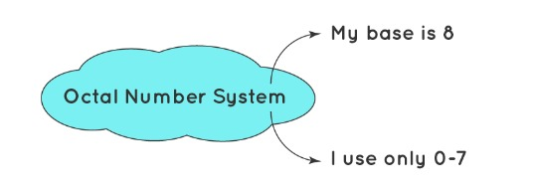
3- Octal Number System

Slide 7

Convert from one number system into another.

Slide 8
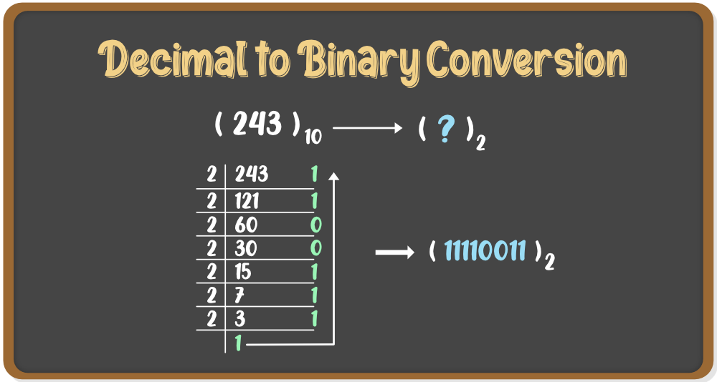
1- Decimal to Binary Conversion

Slide 9
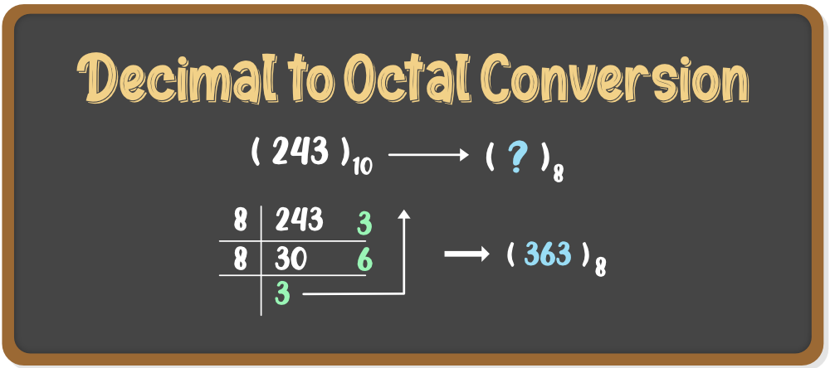
2- Decimal to Octal Conversion

Slide 10
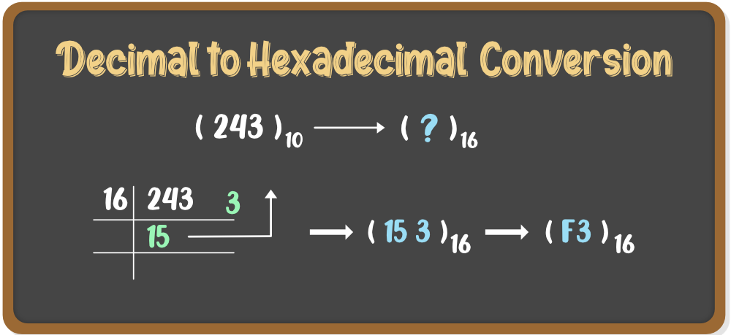
3- Decimal to Hexadecimal Conversion

Slide 11
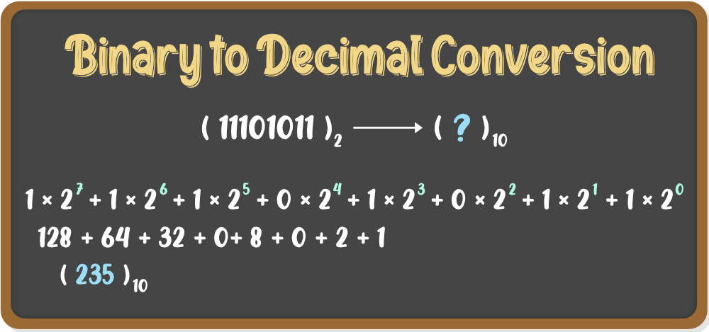
4- Binary to Decimal Conversion

Slide 12
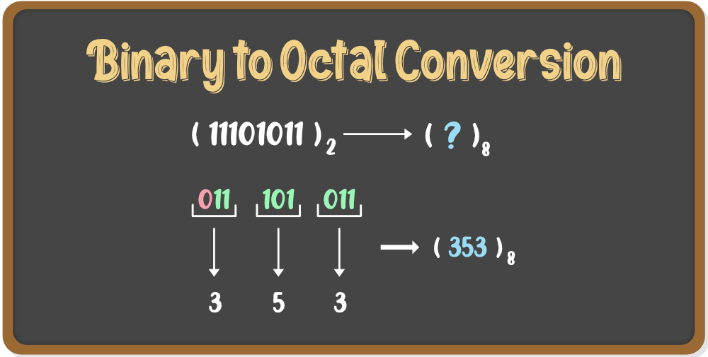
5- Binary to Octal Conversion

Slide 13
6- Binary to Hexadecimal Conversion

Slide 14
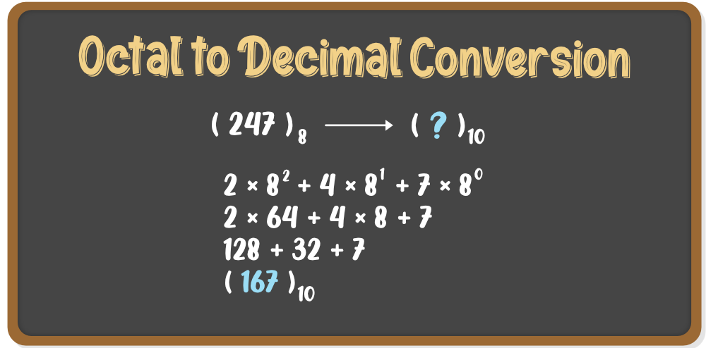
7- Octal to Decimal Conversion

Slide 15
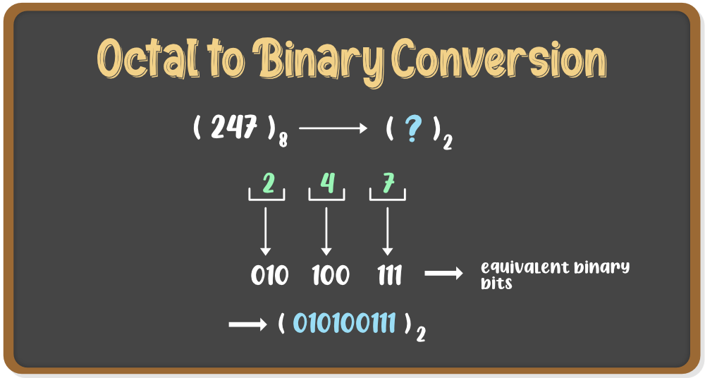
8- Octal to Binary Conversion

Slide 16
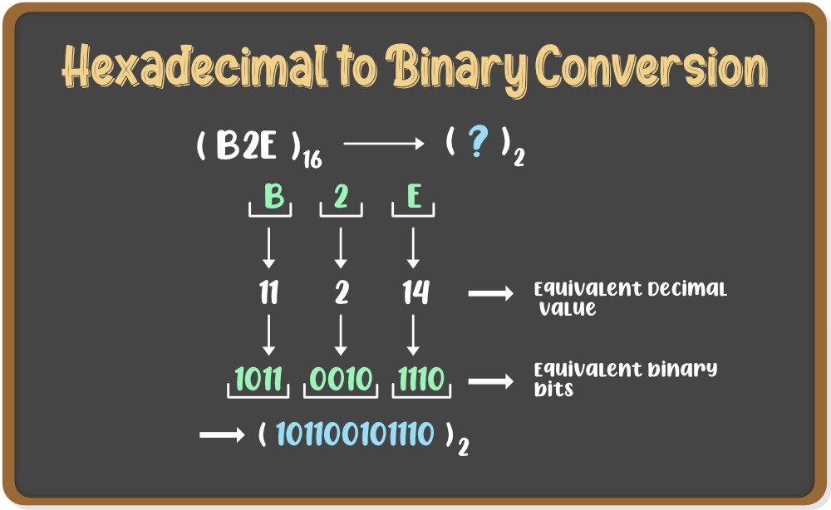
10- Hexadecimal to Binary Conversion

Slide 17
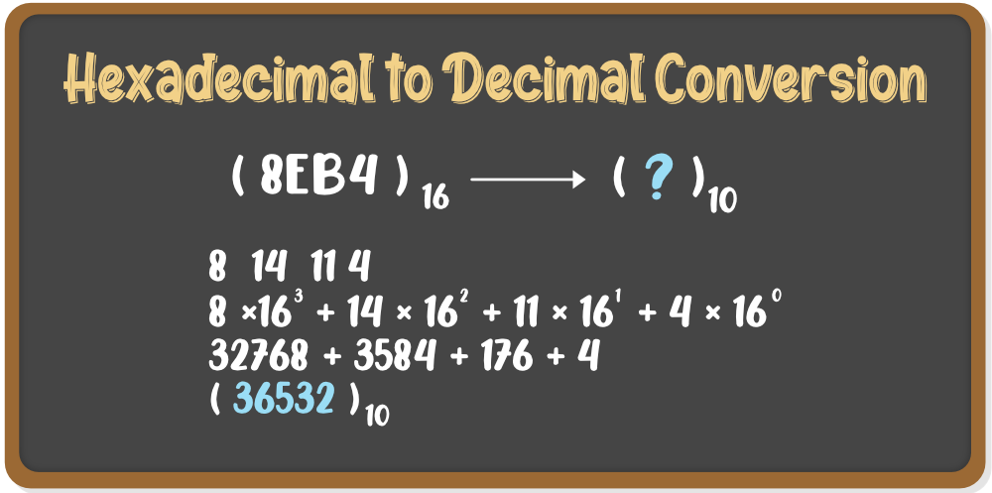
11- Hexadecimal to Decimal Conversion

Slide 18
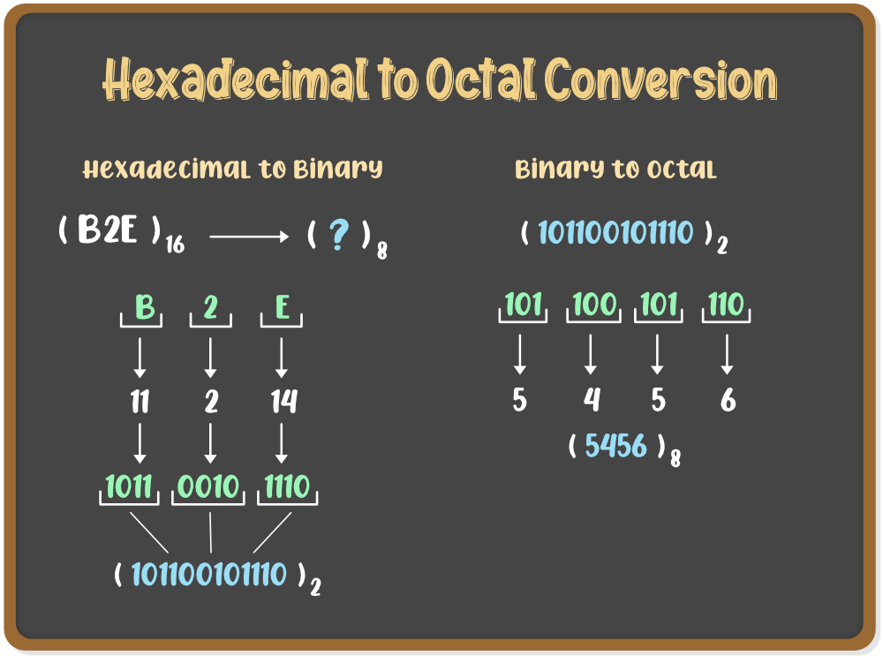
12- Hexadecimal to Octal Conversion

Slide 19
12- Hexadecimal to Octal Conversion

Slide 20
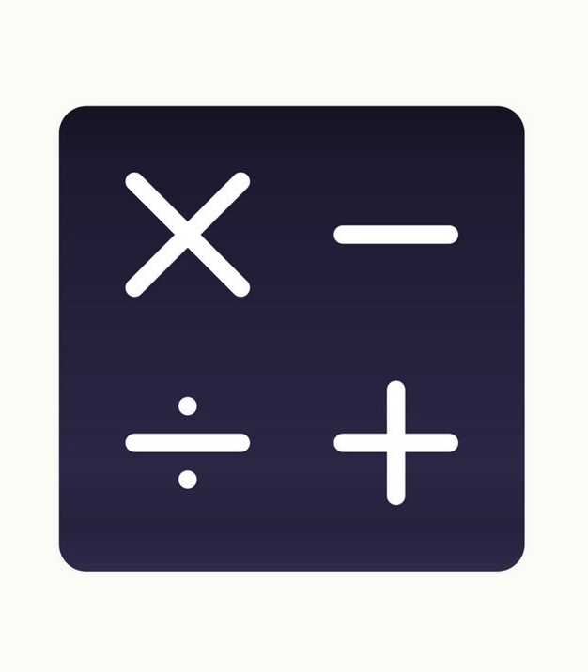
Apply arithmetic operations to binary numbers.

Slide 21
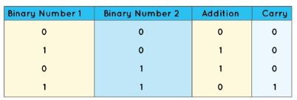
1-Binary Addition

Slide 22
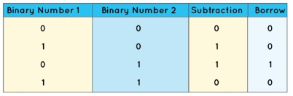
2-Binary Subtraction

Slide 23

Part Two

Slide 24
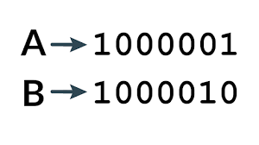
Text in Binary

Slide 25
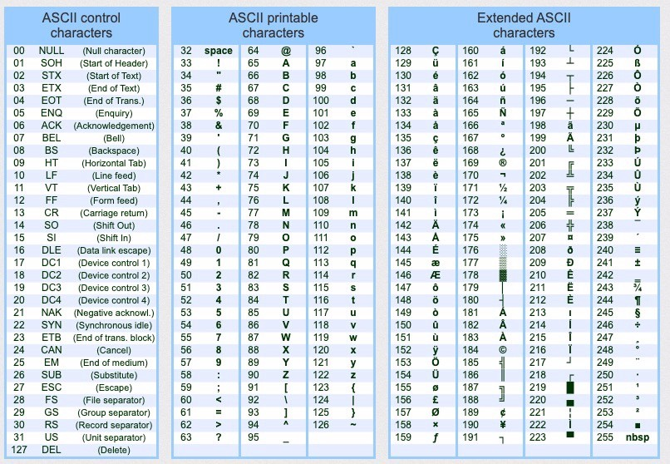
ASCII Table

Slide 26
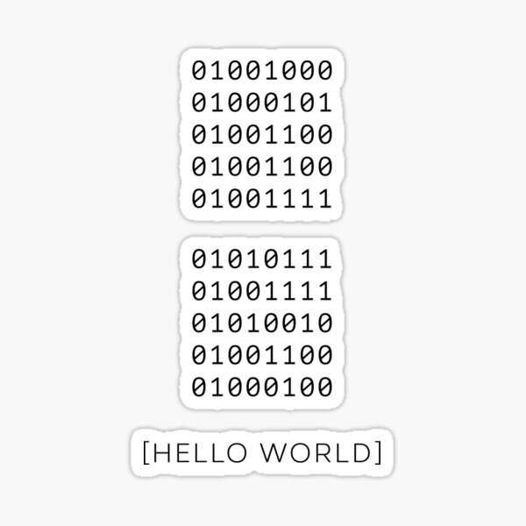

Slide 27
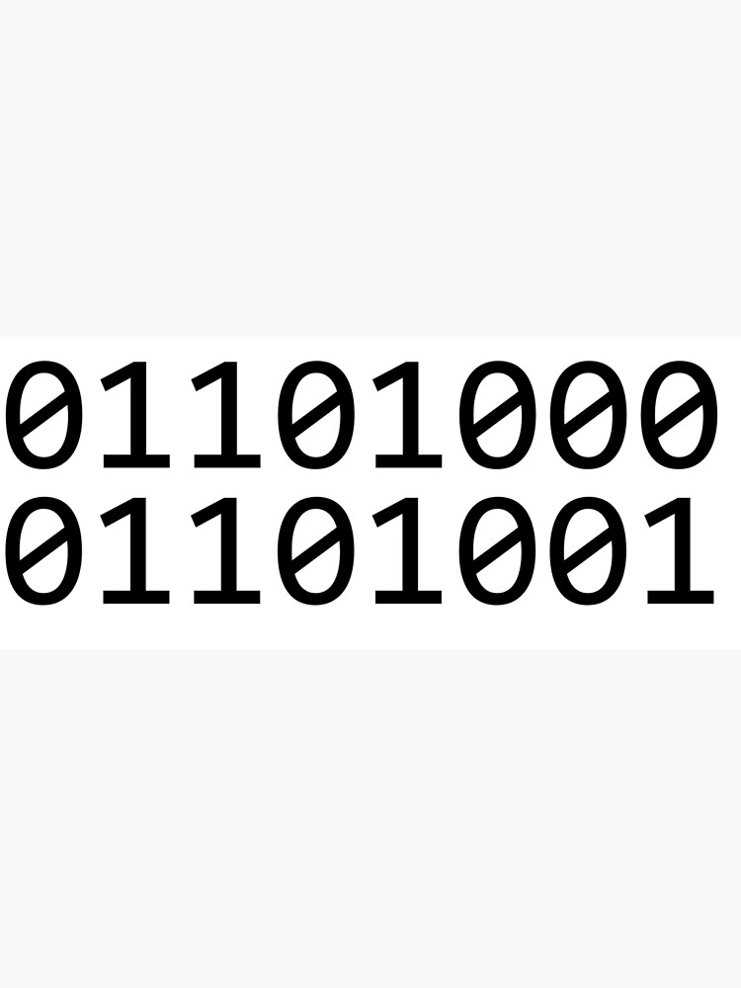
hi! In Binary

Slide 28
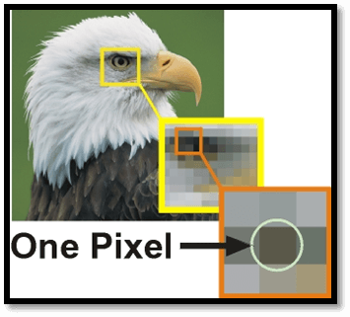
Images Making

Slide 29
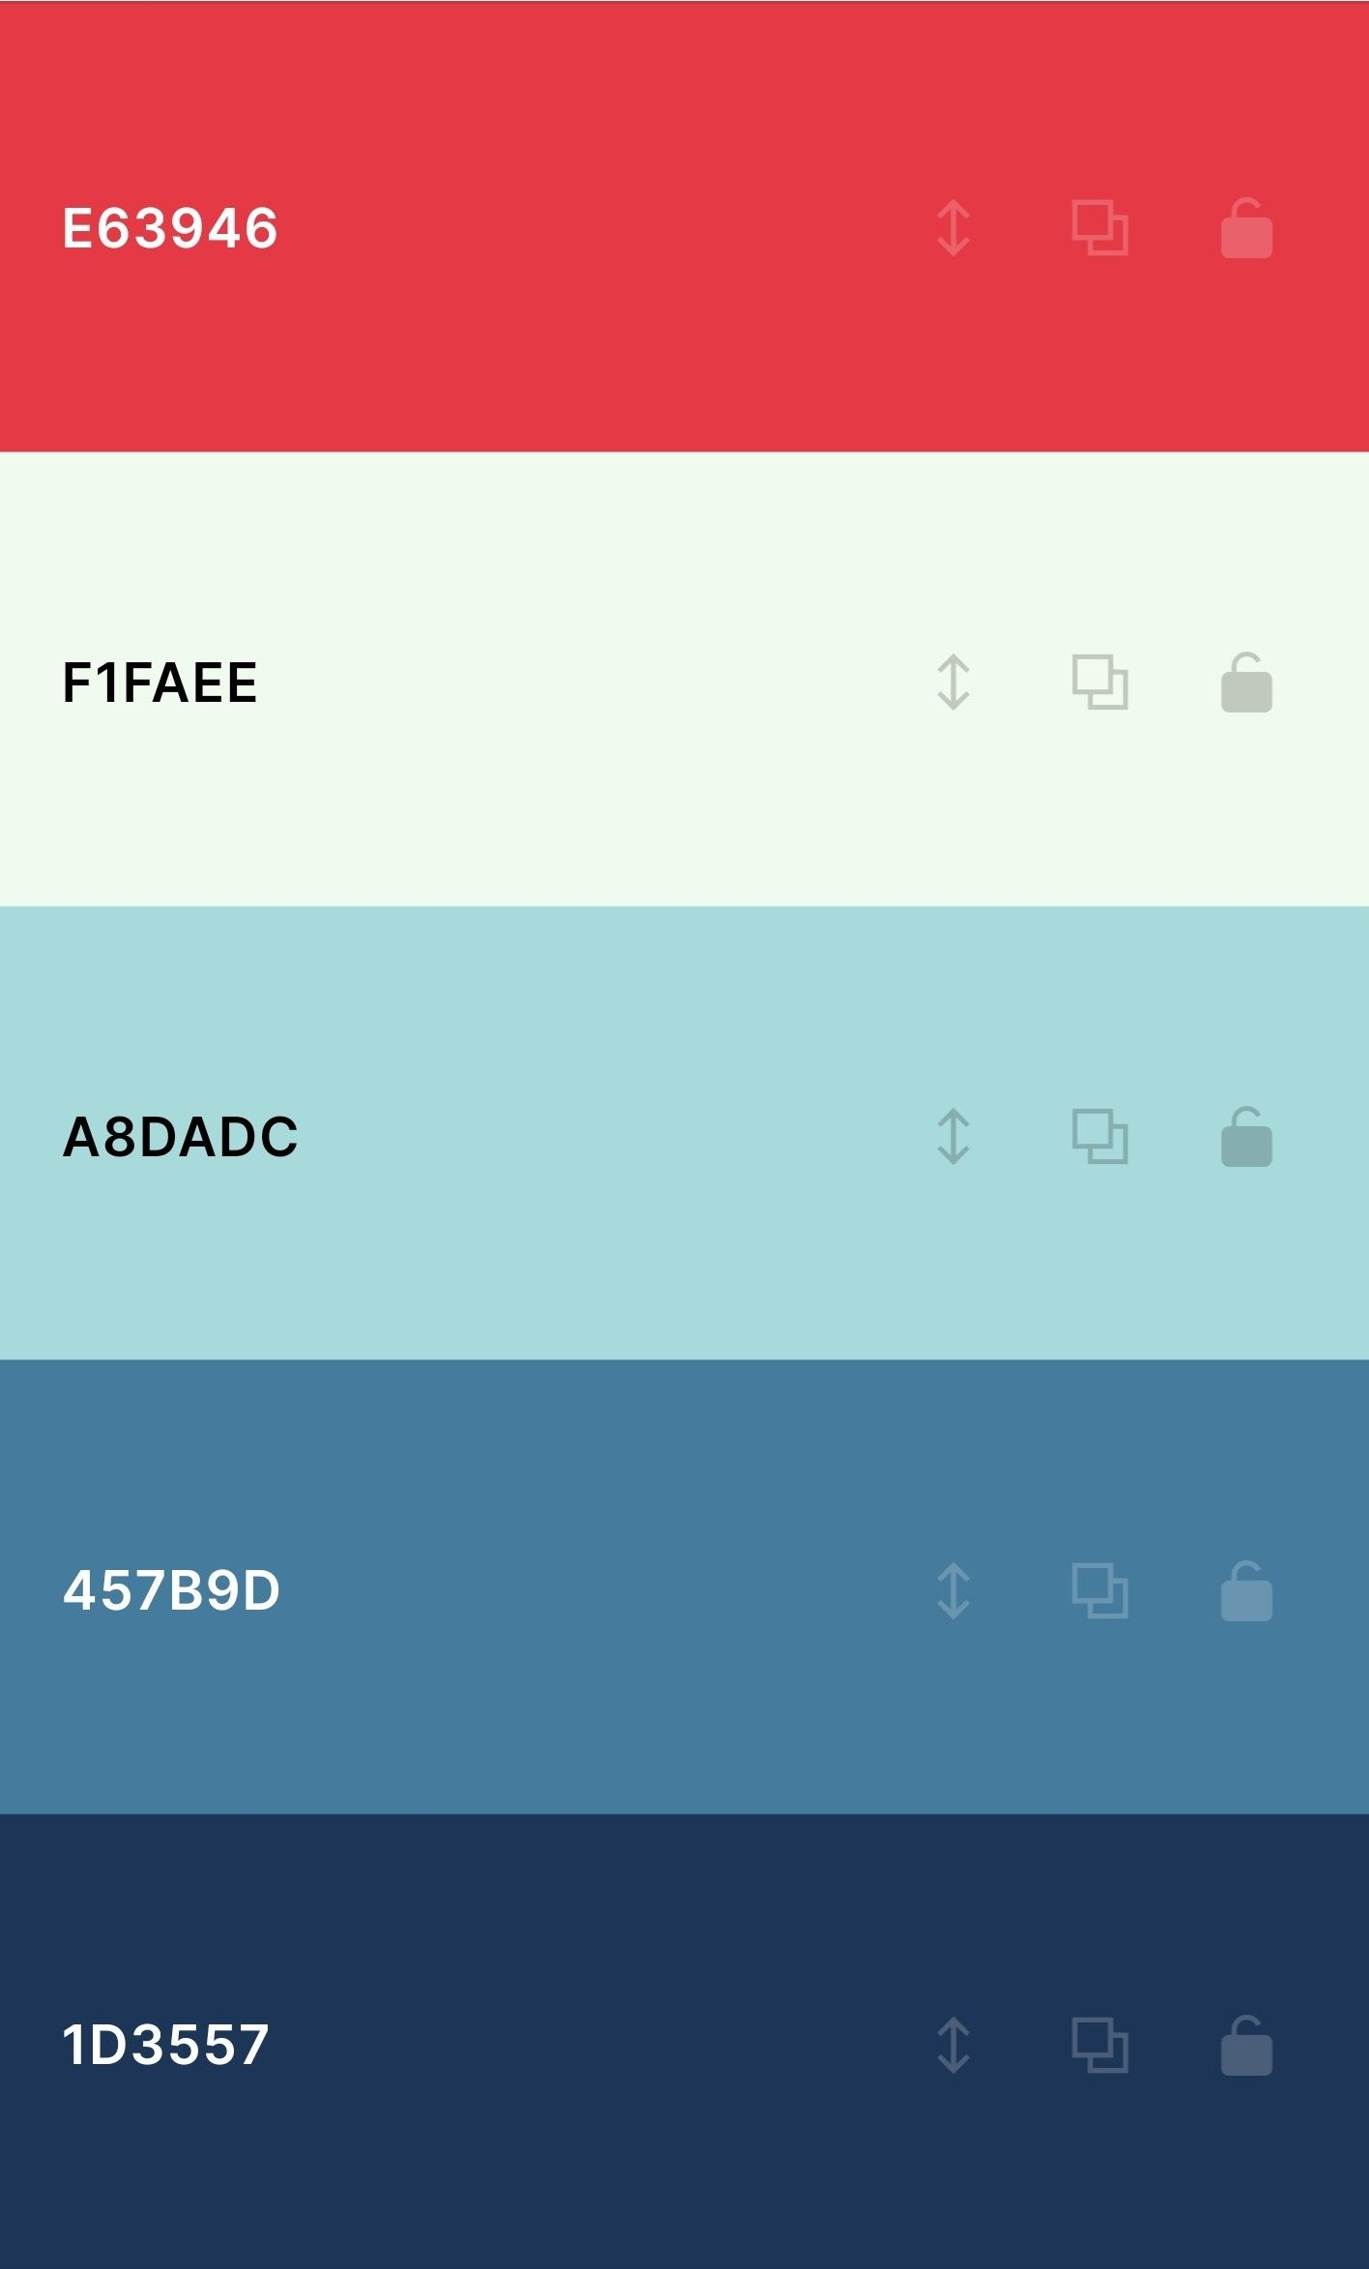
Colors In Hexadecimal Code

Slide 30



Slide 31

Images Contains Pixels

Slide 32

Video Making

Slide 33


